Slide 1
Anomaly Detection in Cellular Networks
Wilmer Tejada

Slide 2
Problem
We need to be able to anticipate variations in the user’s traffic demands. This would allow for the efficient management of the scarce network resources. In this case we will attempt to predict anomalies in cellular networks using ML.

Slide 3
Steps Involved
Importing the required packages and data
Processing the data to our needs
Feature selection and data split
Building our classification models
Evaluating our models

Slide 4
1. Importing the required packages and data
Data set from Kaggle
Packages required:
Pandas, NumPy, Scikit Learn, XGBoost

Slide 5
2. Processing the data to our needs
Remove any duplicate data (106 out of 36,904)
Fix incorrect labels and coerce data types.
Encode all strings into numeric values in order to feed them to our algorithms.
Change NaN to 0.
Remove outliers from dataset.
Normalize all our data.
See if we need to rebalance our dataset.
Compare our features to our target variable.

Slide 6
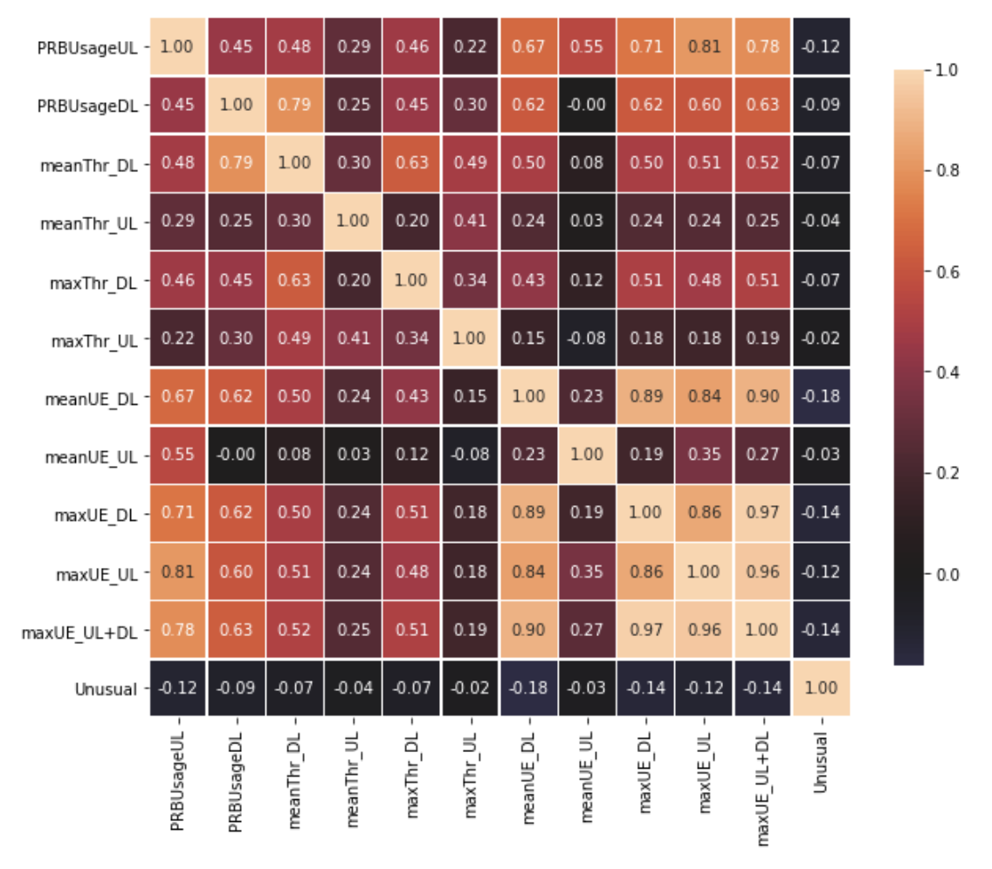
Correlation Matrix
Low correlation between features and target variable implies a non-linear relationship.
Notes:
Because of this lack of linearity, tree based methods will outperform regression. We can test regression as well just to have it as a baseline.

Slide 7
3. Feature selection and data split
Because our dataset is small, we can keep all of our columns without any computational power worries. Otherwise, we could use dimensionality reduction techniques such as Principal Component Analysis or Recursive Feature Elimination.
We split our dataset into 80% Train/ 20% Test.

Slide 8
4. Building our classification models
Because this is a binary classification problem, I chose to use the following algorithms:
Decision Tree
K-nn
Log Regression
Random Forest
XGBoost

Slide 9
5. Evaluating our models
Accuracy
Precision
Recall
F1 Score

Slide 10
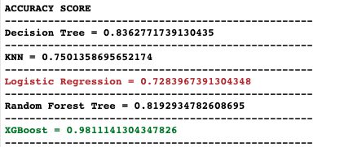
Accuracy
Correct predictions/All predictions

Slide 11
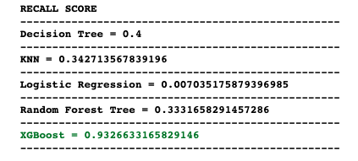
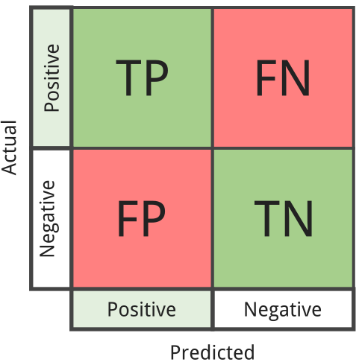
Recall = tp / (tp + fn)
The recall is intuitively the ability of the classifier to find all the positive samples.
Notes:
For example for a medical diagnosis, it is better to maximize recall here because we rather have somebody test positive for a diagnosis and them not actually have it that somebody test negative when they actually DO have a medical condition. when we increase the recall, we decrease the precision.

Slide 12
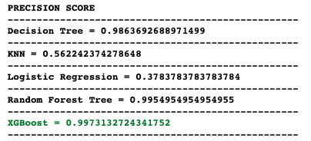
Precision = tp / (tp + fp)
The precision is intuitively the ability of the classifier not to label a sample that is negative as positive.
Notes:
Precision is ability of a classification model to identify only the relevant data points. For medical diagnosis, if this model labels everybody as having a certain diagnosis then it isn’t too great of a model.

Slide 13
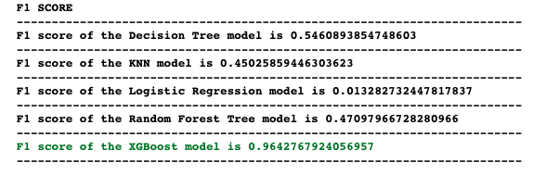
F1 score = 2((precision * recall) / (precision + recall))
The F1 score can be interpreted as a weighted average of the precision and recall

Slide 14
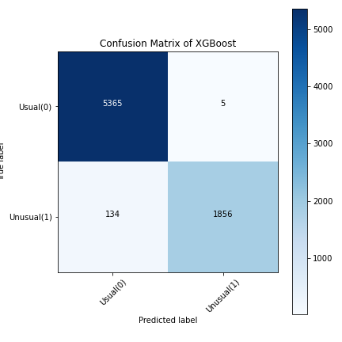
Confusion Matrix for XGBoost

Slide 15
Comments
The simpler learners are not accurate enough on their own. Using an ensemble method like XGBoost is powerful is because rather than just combining the isolated classifiers, it uses the mechanism of uplifting the weights of misclassified data points in the preceding classifiers. With Boosting, new models are added to correct the errors made by existing models. Models are added sequentially until no further improvements can be made.

Slide 16
What’s next?
Because this model was built with python, it can be deployed anywhere python code can be deployed. This also includes AWS, GCP, Azure, etc. Using the pickle library simplifies this quite a bit as it allows you to store model weights and parameters.

